Slide 1
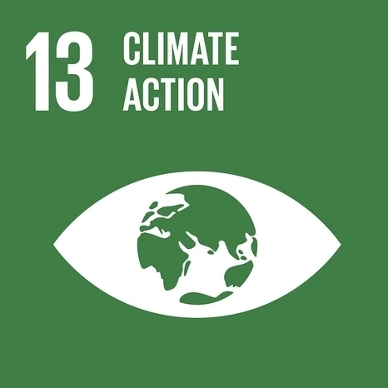
UN PRME Climate Change and Environment Working Group
Prof. Dr. Petra Molthan-Hill
Professor of Sustainable Management and Education for Sustainable Development, Nottingham Business School (NBS),UK and Co-Chair UN PRME Working Group on Climate Change & the Environment
Dr. Alex Hope
Deputy Pro Vice-Chancellor and Deputy Dean of Newcastle Business School. Co-Chair UN PRME Working Group on Climate Change & the Environment, Steering
Dr. Rachel Welton
Assistant Head of UG NBS and Deputy Chair UN PRME Working Group on Climate Change & the Environment
Dr. Muhammad Mazhar
Senior Lecturer in Sustainability at NBS and Policies & Strategies Subgroup Coordinator

Slide 2
Presentation overview
The focus of the PRME WG is that everyone in Business School’s understands climate change mitigation and develops climate change mitigation capacity, to enable everyone to act upon it.
Our working group:
a) Overview of climate change education in business schools: current strategies and links to WG CC & E (Petra)
b) WG CC & E survey, recent publications, and research (Alex)
c) WG CC & E Carbon Management updates (Muhammad)
d) WG CC & E upcoming events (Rachel)
Notes:
Or working group would like to present the attached (which will be soon finalised) covering the following topic:
The need for everyone in the business school to understand climate change and climate change mitigation and act upon it.
Climate change education in business schools: strategies Our working group:
a) Overview (Petra)
b) Our survey, recent publications, and research (Alex)
c) Carbon Management and templates (Muhammad)
d) Our upcoming events (Rachel)
The first slides might be narrated by different people (to be decided).
For the recording: We could do Thursday 20.05. between 9-12.30 BST. Maybe 11.00-12.30 BST would be best given your time zones? We would appreciate if you could confirm the date and time soon so that we can block it in our diaries.
Or working group would like to present the attached (which will be soon finalised) covering the following topic:
The need for everyone in the business school to understand climate change and climate change mitigation and act upon it.
Climate change education in business schools: strategies for every discipline
Our working group:
a) Overview (Petra)
b) Our survey, recent publications, and research (Alex)
c) Carbon Management and templates (Muhammad)
d) Our upcoming events (Rachel)
The first slides might be narrated by different people (to be decided).
For the recording: We could do Thursday 20.05. between 9-12.30 BST. Maybe 11.00-12.30 BST would be best given your time zones? We would appreciate if you could confirm the date and time soon so that we can block it in our diaries.

Slide 3
Background
This PRME Working Group was configured at the Global Forum 2015 in New York.
The focus is on SDG 13 ’Climate Action’ but through SDG 13 we address all the other SDGs
The aim of this Working Group goes beyond that of assisting business schools, it also aims to act as a resource for all organizations who wish to embed climate change and environmental education into their teaching and training.
Currently we have 270 members from over 100 HEIs in 33 countries
Please sign up as member: https://www.unprmeclimate.org/
Notes:
By 2030, ensure that all learners acquire the knowledge and skills needed to promote sustainable development, climate change mitigation and adaptation
Increase from 30 members in 2018 and 14 countries

Slide 4
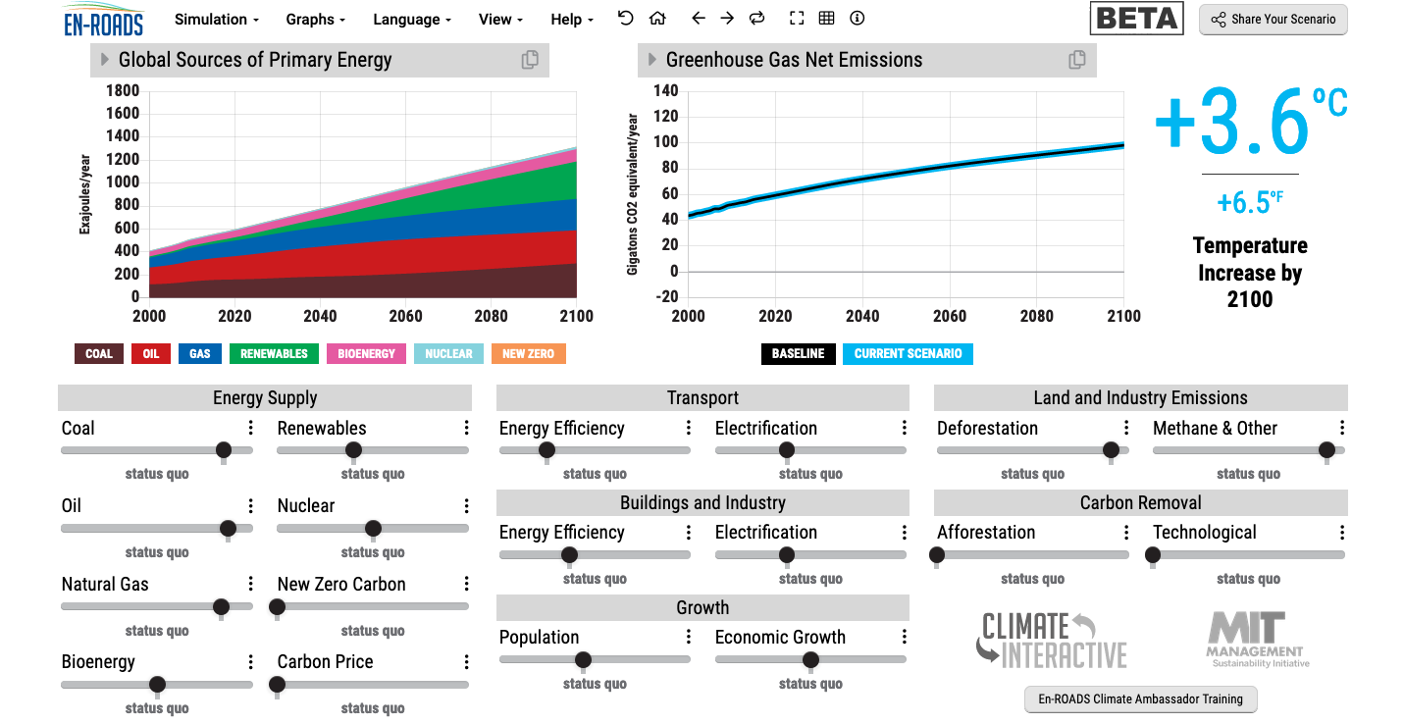
En-ROADS is a cutting-edge simulation model used to test climate solutions and generate climate scenarios for the future.
Notes:
This is our current situation as demonstrated by En-ROADS which was developed by MIT Climate Interactive so that everyone can understand the high impact solutions and which impact they would have.

Slide 5

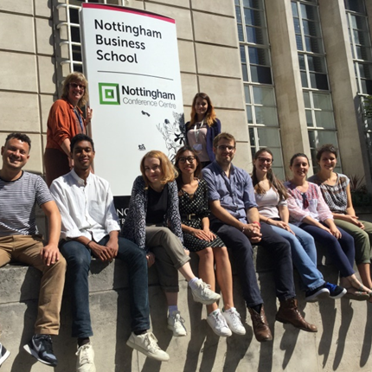

Carbon Literacy Training for Business Schools
What if every recruit into corporations from the world’s business schools was qualified as Carbon Literate?
This training was developed by Nottingham Business School (Nottingham Trent University) in collaboration with the UN PRME Champions, Oikos International and the Carbon Literacy Project.
The aim of this project is to get academics, students and others Carbon Literate within a short time frame and to get as many people as possible actively involved in embedding climate solutions in their own life and work. In order to do so we have chosen a train-the-trainer approach, so we will offer regional events inviting all the universities and business schools in the vicinity to train academics and students there so that they can become trainers in their own institution and/or involved in training other in other regions of the world.
Notes:
In our Carbon Literacy Training for Business Schools we have a strong focus on these high impact solutions so that everyone in a business school, whether in teaching, research or operations would know the best actions to take.

Slide 6
1. Climate Change Mitigation
1. Climate Change Science Education
Knowledge and understanding of a broad range of scientific concepts and processes related to climate change (e.g. climate, deforestation, habitat loss, water cycle, soil erosion, air pollution), its causes and its consequences, ecologically, socially, economically and politically.
Knowledge and understanding of the dynamics of climate change impact across time and space (e.g. delayed consequences, reducing the quality of life, security and development options of future generations).
Awareness of strategies and technologies to address the negative impacts of climate change (e.g., reducing carbon consumption, encouraging low-carbon development, reducing deforestation through sustainable forest management, improving water and waste management).
Ability to distinguish critically between certainties, uncertainties, projections and risks associated with climate change and to evaluate messages about and public interpretations of climate change science.
This table will be published in: Molthan-Hill, P et al (2021), Climate change education at universities: Relevance and strategies for every discipline. in: Handbook of Climate Change Adaptation and Mitigation (3rd edition), Springer: Cham, Switzerland, forthcoming. Adapted from definitions provided by Mochizuki Y, Bryan A (2015) Climate change education in the context of education for sustainable development: Rationale and principles. Research 9(1): 4-26.
Notes:
We need to distinguish between three areas of climate change education, the first one is the science: Every Graduate need to understand the climate change science enough to make informed decisions and integrate high impact solutions into their life and work. This basic understanding is also necessary for anyone studying business.

Slide 7
1. Climate Change Mitigation
2. Climate Change Mitigation Education
Developing values, knowledge and skills required to make choices and decisions that minimize the use of natural resources, emissions, waste and pollution, while contributing to the development of new solutions to the climate crisis (e.g., rethinking the way we live, buy and consume, how our daily lives are organized, how we socialize, exchange, share, educate and build identities).
Taking individual and/or collective action with the potential to have immediate, direct impact (e.g., reducing energy consumption, using non-polluting and renewable energy sources, environmental conservation, re-forestation and re-greening).
Contributing to policy development with long-term positive impact on societal behavior by examining economic systems, social structures, cultural patterns, lifestyle expectations, consumerism, wealth distribution, aspirations and value systems and their underlying responsibility for excessive greenhouse gas production.
This table will be published in: Molthan-Hill, P et al (2021), Climate change education at universities: Relevance and strategies for every discipline. in: Handbook of Climate Change Adaptation and Mitigation (3rd edition), Springer: Cham, Switzerland, forthcoming. Adapted from definitions provided by Mochizuki Y, Bryan A (2015) Climate change education in the context of education for sustainable development: Rationale and principles. Research 9(1): 4-26.
Notes:
The second one is Climate Change Mitigation Education: Every Graduate needs to know how to best mitigate climate change- what are the best strategies and tools in operations, supply chain management, economics, investment to reduce carbon emissions?

Slide 8
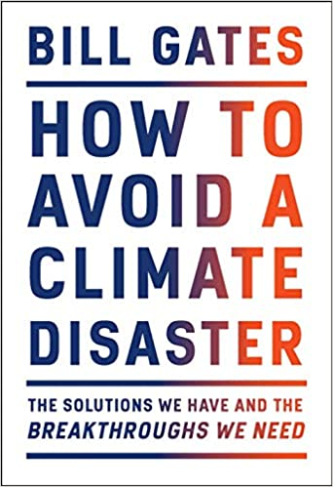

Just published
1. Climate Change Mitigation
Notes:
Knowing these climate change mitigation tools and strategies will allow them to judge, whether Bill Gates is suggesting good solutions in his new book or whether Mark Carney got it right.

Slide 9
1. Climate Change Mitigation
3. Climate Change Adaptation Education
Building capacity to apply these strategies in future situations, when the delayed impacts of climate change make themselves felt.
Knowledge and understanding of tools and methodologies to respond promptly and effectively in areas that have been negatively impacted by climate change, including Disaster Risk Reduction (DRR) strategies such as community disaster committees, community evacuation and rescue plans, and local first-aid training.
Knowledge and understanding of tools and methodologies to rebuild and restore areas that have been negatively impacted by climate change (e.g., seashores, flood prevention measures).
Implementing measures that reduce the vulnerability of natural and human systems to the impacts of climate change.
Advocating for appropriate channelling of resources at global level to protect negatively affected natural and human systems in a just and equitable way.
This table will be published in: Molthan-Hill, P et al (2021), Climate change education at universities: Relevance and strategies for every discipline. in: Handbook of Climate Change Adaptation and Mitigation (3rd edition), Springer: Cham, Switzerland, forthcoming. Adapted from definitions provided by Mochizuki Y, Bryan A (2015) Climate change education in the context of education for sustainable development: Rationale and principles. Research 9(1): 4-26.
Notes:
In many countries Graduates need to learn how to adapt to climate change now, however in the UK and other high emitting countries the focus should be on mitigation: Is it not better to mitigate against the flooding of London so that major floods will not happen in the near future than to build higher flood defences now?

Slide 10
NTU Carbon Literacy Training Course
Climate change mitigation and focused on solutions
Interactive teaching material
MIT Sloan & Climate Interactive Simulation tool
Certificates for you and your students
www.ntu.ac.uk
Please contact petra.molthan-hill@ntu.ac.uk for more info on this or the more specific training for business schools mentioned earlier.
Notes:
And if you are interested in the wider perspective on how to get everyone in the university carbon literate, NTU has made one of the two open-source tool kits for all staff and students at universities.

Slide 11
Recent publications, and research
Molthan-Hill, P., Hope, A., & Welton, R. (2020). Tackling Climate Change through Management Education. The SAGE Handbook of Responsible Management Learning and Education, 165.
Molthan-Hill, P., Robinson, Z. P., Hope, A., Dharmasasmita, A., & McManus, E. (2020). Reducing carbon emissions in business through Responsible Management Education: Influence at the micro-, meso- and macro-levels. The International Journal of Management Education, 18(1), 100328.
Mbah, M., Ajaps, S., & Molthan-Hill, P. (2021). A Systematic Review of the Deployment of Indigenous Knowledge Systems towards Climate Change Adaptation in Developing World Contexts: Implications for Climate Change Education. Sustainability, 13(9), 4811.
Molthan-Hill, P., Worsfold, N., Nagy, G. J., Leal Filho, W., & Mifsud, M. (2019). Climate change education for universities: A conceptual framework from an international study. Journal of cleaner production.

Slide 12
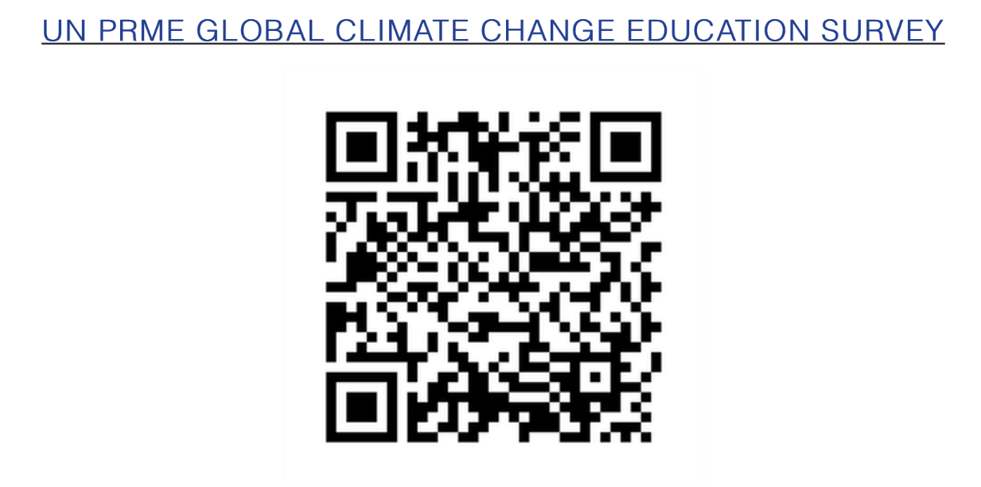

Climate Change Education Survey
240 responses to date
98% agree climate change is a legitimate topic to be taught in Business Schools
Only 45% do some teaching in this area
Lack of expertise and space in the curriculum biggest challenges

Slide 13
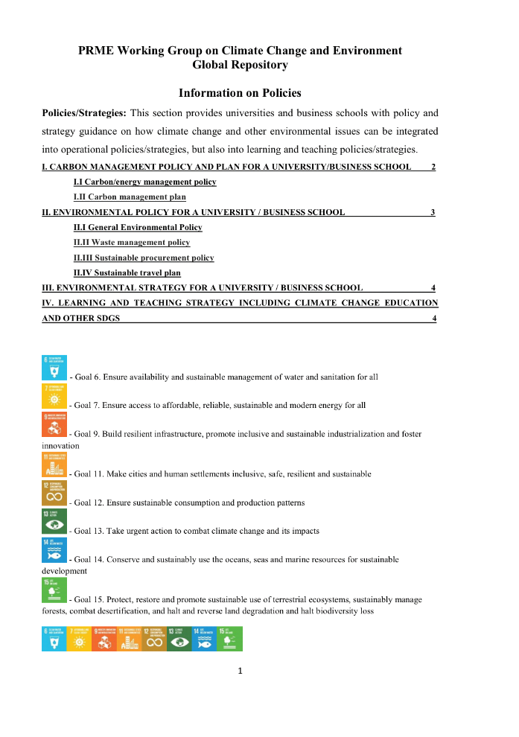
Policies and Strategies Subgroup
Policies and Strategies subgroup aims at carbon management in universities and business schools
Strives to provide strategic support and resources
Policy and strategy templates and good practice examples are available
Focus on operational policies/strategies and also in teaching and learning
Has a Coordinator to oversee resources and offer information

Slide 14
Repository and Key Areas
Resources are available as a starting point on PRME Working Group on Climate Change and Environment Repository
The templates cover the following areas:
  a) Carbon Policy for a business school/university
  b) Environmental Policy for a business school/university
  c) Environmental strategy for a business school/university
  d) Learning and teaching strategy including climate change education and other SDGs
Ideas to share knowledge and good practices for replication and learning not only within the Working Group but beyond

Slide 15
Future Plans
Work in progress and way to go
Ambition to bring resources and good practice examples from institutions across the world
Contributions and material from you are welcome
Organise online sessions, events and webinars for staff development
Aim to involve practitioners

Slide 16
Call for expression of interest in WG CC & E
Opportunities for:
Secretary – to produce a regular newsletter and updates, manage the signed up members
Social media influencer – connect into different networks and promote the work of the group
Event Manager – to manage several events during the year.
Peer Support Groups for CLT – international groups linking into the Chapters

Slide 17
Meetings for people who want to take on smaller or bigger roles in our working group
Tuesday 22.06.21 at 5-6pm BST
Wednesday 23.06.21 at 9-10am BST

Slide 18
Future plans and events 2021-22
Month | Event focus
September 2021 | WG CC & E new member roles and ideas for involvement and events
November 2021 | Peer to Peer Support for CLT and commitments to manage own sessions
January 2022 | Academic themed event 1 – keynote and workshop (Carbon Accounting)
March 2022 | Academic themed event 2 – keynote and workshop (Working with SMEs)
May 2022 | Academic themed event 3 – keynote and workshop (Business perspectives & impact)
July 2022 | WG CC & E annual review and plans for 2022-23

Slide 19
Carbon Literacy Training –prior to CoP26
Global UNPRME & WG CC&E
Feb/ March 2021-22
July – starting 02.07.21, sign up through Global UNPRME
Oct/Nov - sign up through Global UNPRME
For PRME signatories:
CLT Peer group support and CLT rolling out, starting soon:
Australia
France
Germany
Sign up through Global UNPRME
Notes:
Petra – how many on and certified in Feb / March training?

Slide 20

Please do join us, lovely to hear your ideas and share…ideas
Suggestions…Help…
petra.molthan-hill@ntu.ac.uk
muhammadusman.mazhar@ntu.ac.uk
alex.hope@northumbria.ac.uk
rachel.Welton@ntu.ac.uk

