Slide 1
Introducing the DARSHE*: A tool to build and develop scholarship in higher education
*Descriptions of activity related to scholarship of higher education
Gann, R.J. & Hulme, J.A. (under review). Scholarship reimagined: Creating the DARSHE, an inclusive and flexible model for scholarship in higher education. Higher Education.
Rose.Gann@ntu.ac.uk
Julie.Hulme@ntu.ac.uk
Notes:
2.20-3.20pm Tuesday
Getting promoted in higher education is hard, and getting promoted in the context of an education-focused career is even harder! In this workshop, we will explore how we can conceptualise scholarship activities, turn our teaching into outputs, and raise our scholarship profiles. Rose and Julie will introduce the Description of Activities Related to Scholarship of Higher Education model (DARSHE; Gann & Hulme, under review) as a way to reflect on and plan your own scholarship, and/or to facilitate the development of others. This may be because you are seeking promotion on the education career track, or supporting others to do so, or it may be that you are interested in finding out more about scholarship and how it might connect with your teaching and practice. Whatever stage you, or those you support are at, if you are working in Higher Education, come and join us to explore your scholarship identity and see if the DARSHE might be a useful and inclusive tool to use in your own institutional context.

Slide 2
Introducing the DARSHE – what was the issue, and how did we solve it?
Background – defining scholarship
Growing numbers of education-focused academics AND a shifting debate
Mapping scholarship – DART (Kern et al., 2015) but does it privilege just one type of scholarship?
How can we create a framework that enables inclusion of different types of scholarship?

Slide 3
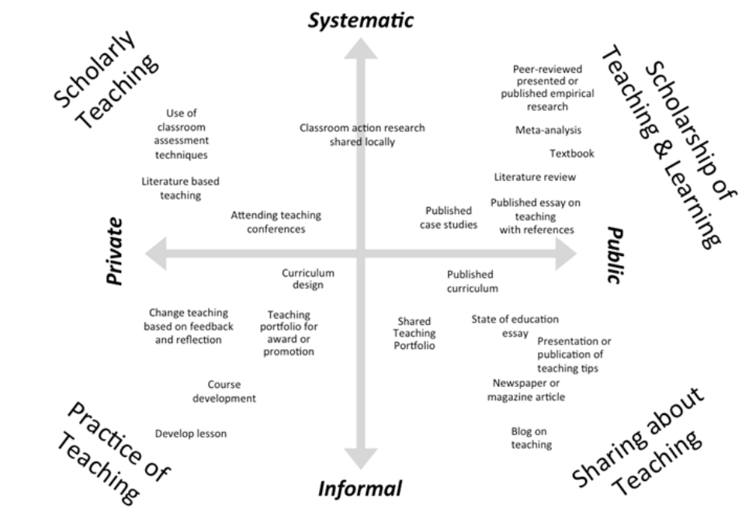

Slide 4
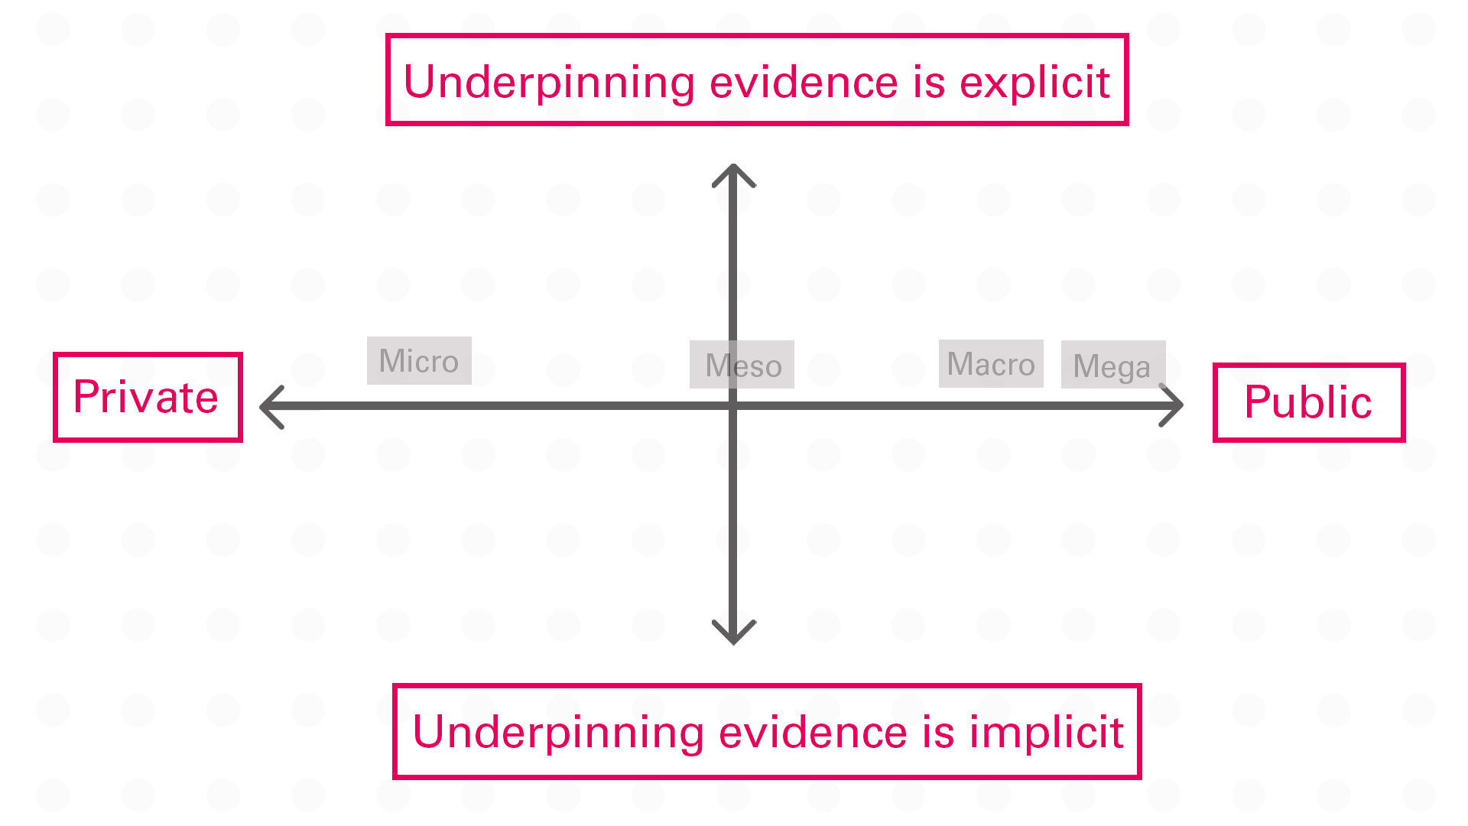

Slide 5
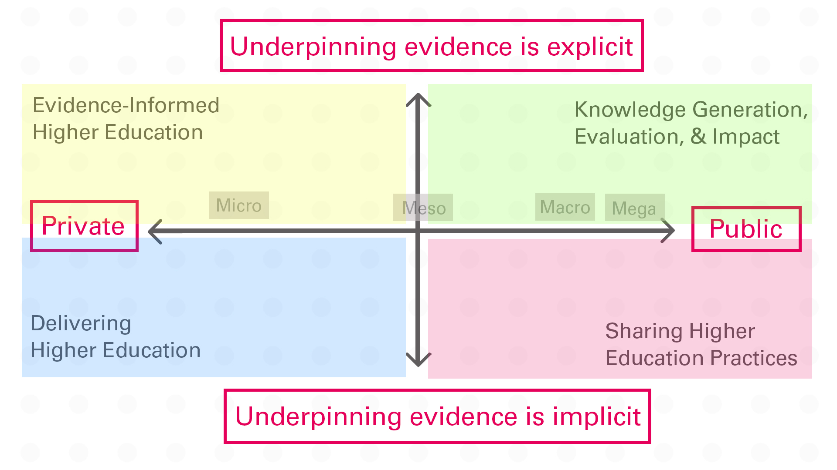

Slide 6
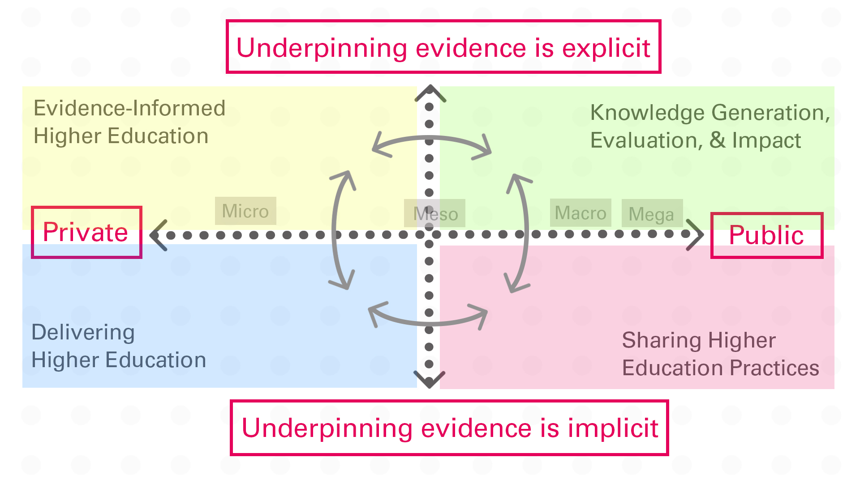

Slide 7
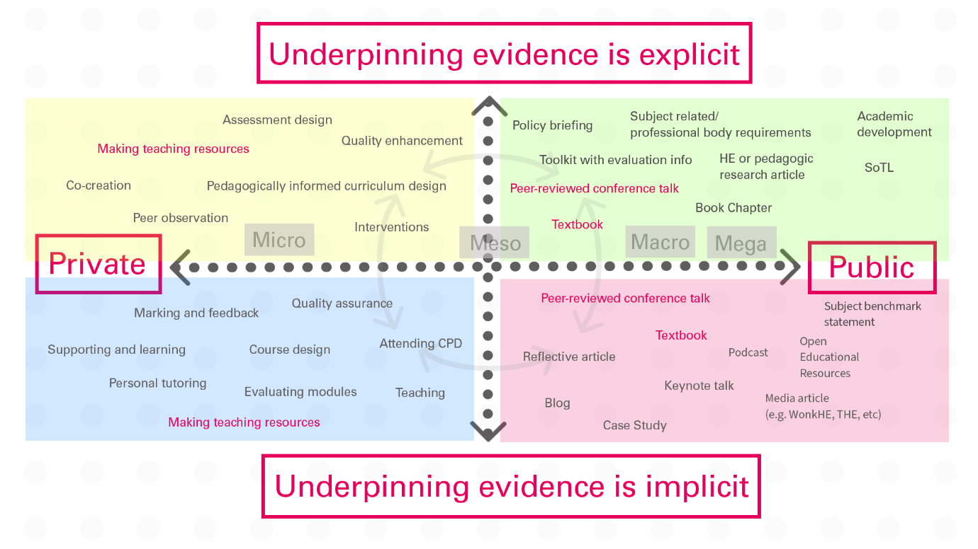

Slide 8
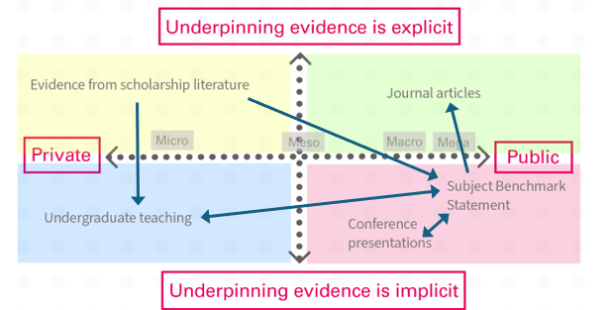

Slide 9
Your turn!

Slide 10

Where are your strengths?
Where can you grow?
Where can you collaborate?
How can you develop reach, impact, value?
What do you still need to know?
Keep in touch?
Rose.Gann@ntu.ac.uk; Julie.Hulme@ntu.ac.uk

